Slide 1

INSTITUTE OF AERONAUTICAL ENGINEERING
Department : Electronics and Communication Engineering
Project title : Investigating the Impact of Variable Non-Linear Activation Function on Skin Lesion Classification with CNN
Mentor : Ms. B Lakshmi Prasanna , Assistant Professor, ECE Department
Presented by ,
B. Vinod Reddy - 20951A04P4
A. Naveen - 20951A04P1
B. Srinivas - 20951A04K7

Slide 2
Problem statement
Skin cancer is a prevalent and growing health concern worldwide.
The incidence of skin cancer has been steadily increasing over the past few decades.
Skin cancer is primarily caused by excessive exposure to ultraviolet (UV) radiation from the sun or artificial sources like tanning beds
Skin cancer can occur in people of all ages, although the risk increases with age.
Skin cancer is a major health problem, and early detection is essential for successful treatment. However, skin cancer can be difficult to diagnose, even by experienced dermatologists

Slide 3
Keywords :
Convolutional neural network (CNN)
Machine learning
Skin lesion classification
Image processing
Melanoma
HAM10000 Dataset
Non linear activation functions
Dermoscopic images

Slide 4
Objectives
Accurately classify skin lesions into benign and malignant categories. This is the most important objective, as it can help to identify and diagnose skin cancer early, when it is most treatable. Differentiate between different types of skin cancer. This is important for accurate diagnosis and treatment planning. Identify skin lesions that are at high risk of becoming malignant. This can help to identify patients who need to be monitored more closely.

Slide 5
Expected outcomes
Improved classification accuracy: The use of variable nonlinear functions can help to capture more complex relationships between the features of skin lesions and their corresponding labels. This can lead to improved classification accuracy, especially for difficult-to-classify lesions.
Reduced overfitting: The use of variable nonlinear functions can help to reduce overfitting, which is a common problem with CNNs. This is because variable nonlinear functions can help to prevent the CNN from memorizing the training data too closely.
Increased robustness to noise: The use of variable nonlinear functions can help to increase the robustness of the CNN to noise in the training data. This is because variable nonlinear functions can help to smooth out the features of the training data, making them less sensitive to noise

Slide 6
Expected outcomes
Automated Diagnosis: CNNs can help automate the process of diagnosing skin lesions by analysing images and providing classification results.
Improved Accuracy: CNNs can achieve high accuracy in distinguishing between different types of skin lesions, including both benign and malignant ones. This can aid dermatologists and healthcare professionals in making more accurate diagnoses and treatment decisions.
Early Detection: Early detection of skin lesions, especially melanoma, is crucial for successful treatment outcomes. CNNs can assist in the early detection of potential malignant lesions by flagging suspicious features that might require further examination

Slide 7

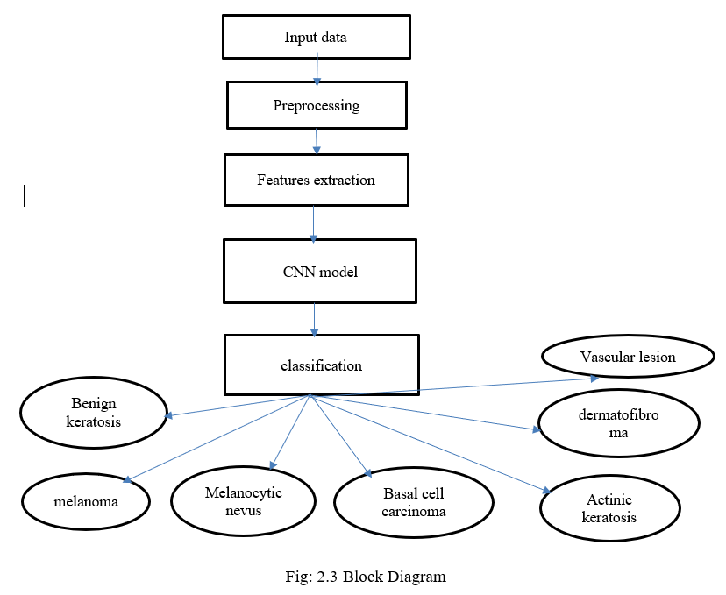
BLOCK DIAGRAM

Slide 8

Literature Survey
S.NO | REFERENCE | AUTHOR & PUBLISHED YEAR | OBJECTIVE | PROS | CONS
1. | Skin Lesion Classification Using Convolutional Neural Network for Melanoma Recognition | Mohamad Li et al By 2020 | This article proposes a framework for skin lesion classification using CNNs. The framework uses image augmentation, transfer learning, and a novel loss function to achieve high accuracy for melanoma recognition. The authors evaluated their framework on the ISIC 2017 skin lesion dataset, and they achieved an average AUC of 87 for melanoma recognition. | The review provides a comprehensive overview of the genetic and molecular alterations leading to NMSC, such as mutations in tumor suppressor genes, oncogenes, DNA repair genes, and epigenetic factors. It also discusses the role of ultraviolet radiation, immunosuppression, inflammation, and viral infections as risk factors for NMSC development. | The review acknowledges that the process of skin carcinogenesis is still not fully understood and that more studies are needed to elucidate the complex interactions between genetic and environmental factors. The therapeutic options for NMSC are still under investigation or have limited efficacy or safety data.
2. | To classify melanomas versus benign nevi using only 399 images from a standard camera. | Pomponiu et al 2018 | The model uses a variable nonlinear activation function, namely ELU, to learn discriminative features from the skin lesion images. | The model achieves high accuracy. | The model is trained on a small dataset.

Slide 9
Literature Survey
S.NO | REFERENCE | AUTHOR & PUBLISHED YEAR | OBJECTIVE | PROS | CONS
3. | Non melanoma skin cancer pathogenesis overview | D. Didona G. Paolino 2018 | Non-melanoma skin cancer (NMSC) is a broad term that encompasses various types of skin cancers, including basal cell carcinoma (BCC) and squamous cell carcinoma (SCC). The pathogenesis of NMSC involves a combination of genetic, environmental, and immunological factors | It also discusses the role of ultraviolet radiation, immunosuppression, inflammation, and viral infections as risk factors for NMSC development. | The review acknowledges that the process of skin carcinogenesis is still not fully understood and that more studies are needed to elucidate the complex interactions between genetic and environmental factors. The therapeutic options for NMSC are still under investigation or have limited efficacy or safety data.
4. | Skin Cancer Classification Using Convolutional Neural Networks with machine learning | T. J. Brinker 2018 | It provides a comprehensive analysis of the use of convolutional neural networks (CNNs) in the classification of skin cancer. It offers evidence-based insights into the effectiveness of CNNs for this application and follows a standardized approach to identify, select, and evaluate relevant studies. | It can also highlight areas where further research is needed, thus guiding future studies and research directions. | It may not cover other approaches or techniques used in skin cancer classification, potentially limiting the breadth of the analysis.

Slide 10
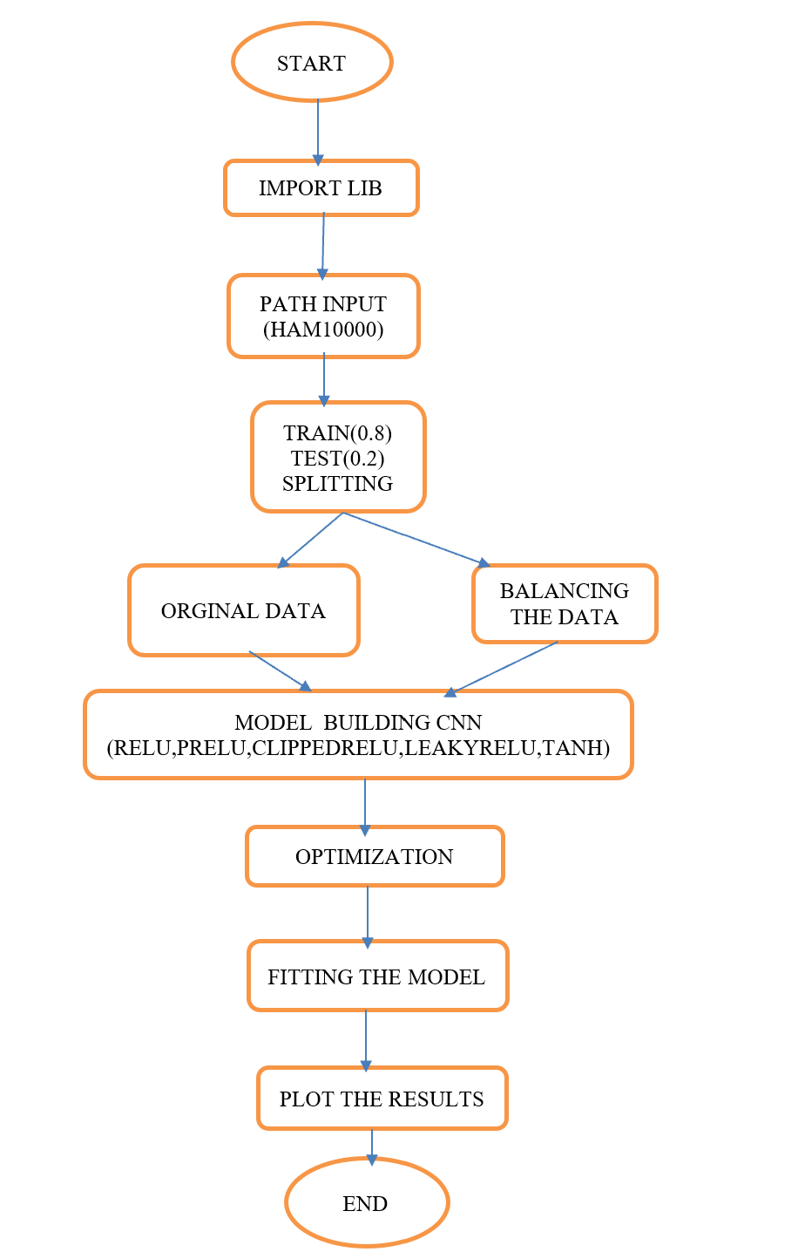
Algorithm
Algorithm:
.

Slide 11
Pandas
Numpy
Matplot lib
Keras
Tensor flow
Pathlib
PIL
Glob
Libraries used :

Slide 12
Methodology
Dataset
pre-processing
Data-augmentation
System implementation
Convolution neural network Architecture
Non linear activation functions
Evalution matrix

Slide 13
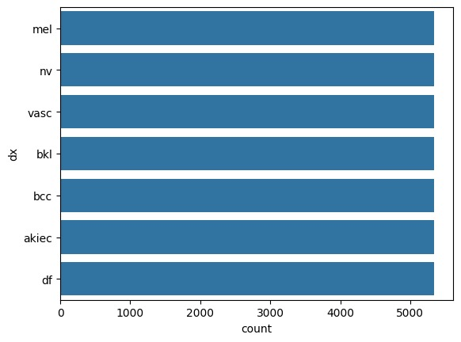
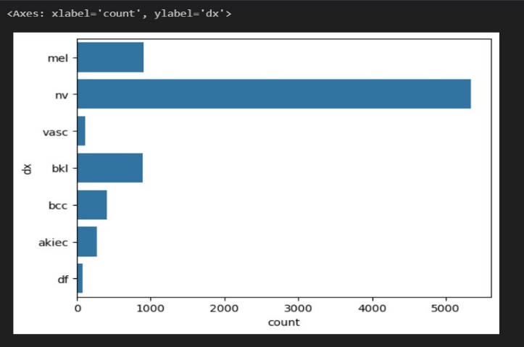
Data Augmentation:
Unbalanced classes Balanced classes

Slide 14
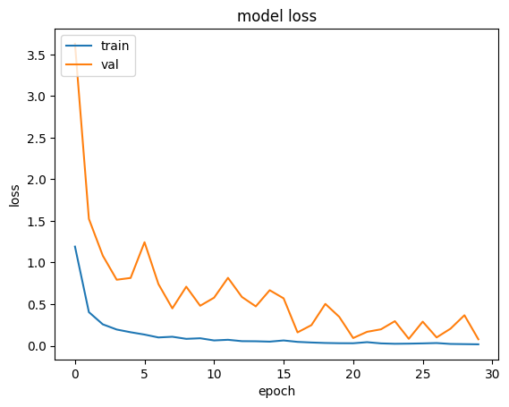
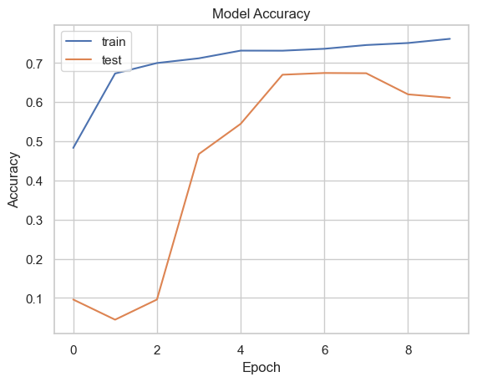
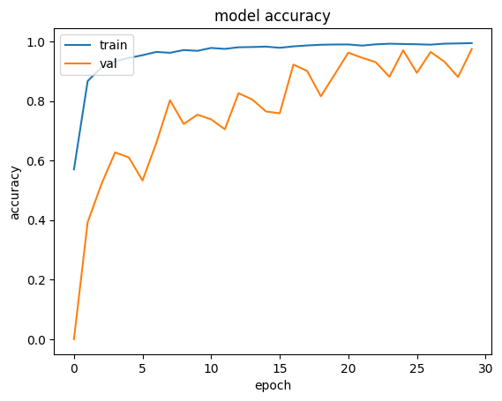
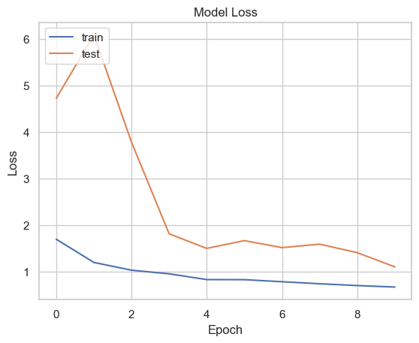
Results
Activation function ReLU
Activation function RELU ( unbalanced )

Slide 15
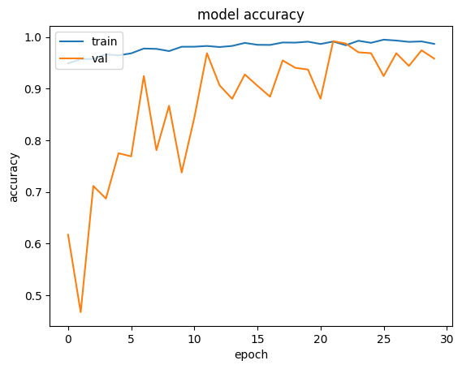
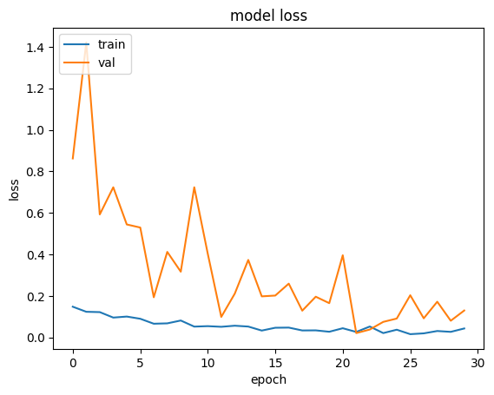
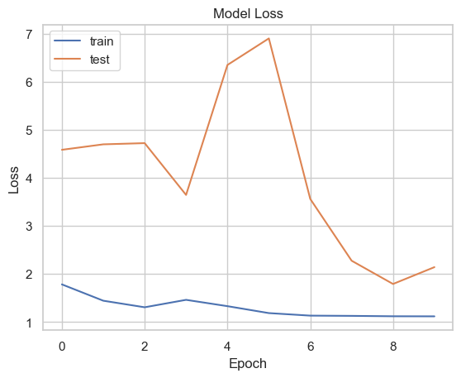
Results
Activation function clipped RELU
Activation function clipped RELU (unbalanced)

Slide 16
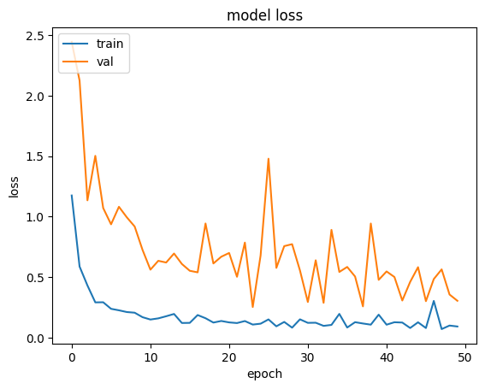
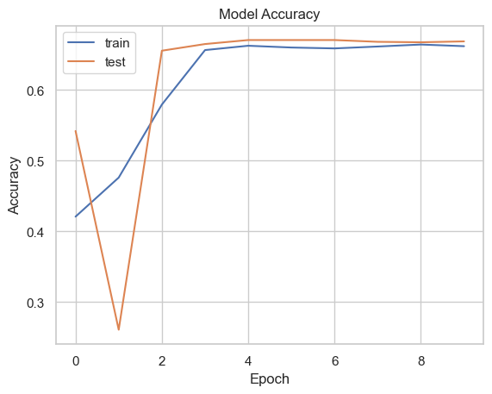
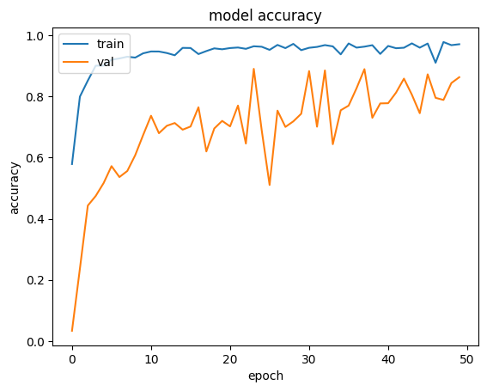
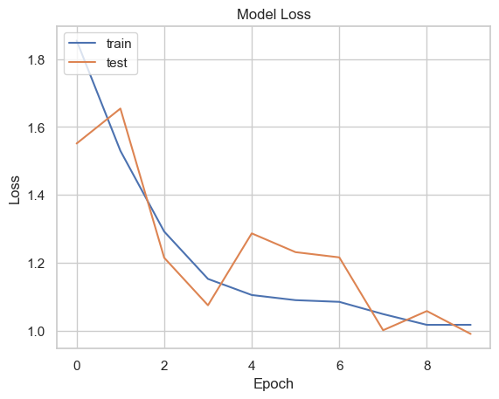
Results
Activation function Hyperbolic Tangent
Activation function Hyperbolic tangent unbalanced

Slide 17
Results
The table describes Nonlinear activation functions results of balanced dataset:
activation | Model accuracy | Model loss | Val- accuracy | Val- loss
ReLU | 97.35 | 2.07 | 96.62 | 6.87
Clipped ReLU | 96.69 | 4.29 | 95.84 | 12.9
Hyperbolic tangent | 95.06 | 9.1 | 86.27 | 3.0
Leaky ReLU | 98.2 | 2.5 | 98.0 | 1.8
ELU | 97.5 | 1.2 | 97.0 | 2.6

Slide 18
Results
The table describes Nonlinear activation functions results of unbalanced dataset:
Activation functions | Model accuracy | Model loss | Val- accuracy | Val-loss
ReLU | 76.16 | 67.48 | 61.10 | 99.79
Clipped ReLU | 66.60 | 71.83 | 43.90 | 98.19
Hyperbolic tangent | 66.20 | 91.71 | 66.88 | 99.03
Leaky ReLU | 79.24 | 57.43 | 69.39 | 93.05
ELU | 78.42 | 61.11 | 67.75 | 71.11

Slide 19
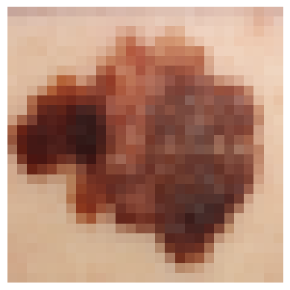
Results
1/1 [==============================] - 0s 30ms/step [2.8528360e-04 5.3492746e-05 9.3629831e-05 1.9489184e-05 8.4941339e-01 2.9593695e-05 1.5010513e-01] ('nv', ‘ melanoma')

Slide 20


